Slide 1

LungVision AI
Ayman Akhras | Kelly Deng | Nathan Luong | Patrick Zhou | Reza Jodeiri
Supervisor: Dr. Mehdi Moradi
Group 27

Slide 2






Outline
Project Motivation
Deep Learning Model
Software Architecture
CI/CD Pipeline
Accomplishments
46.8

Slide 3
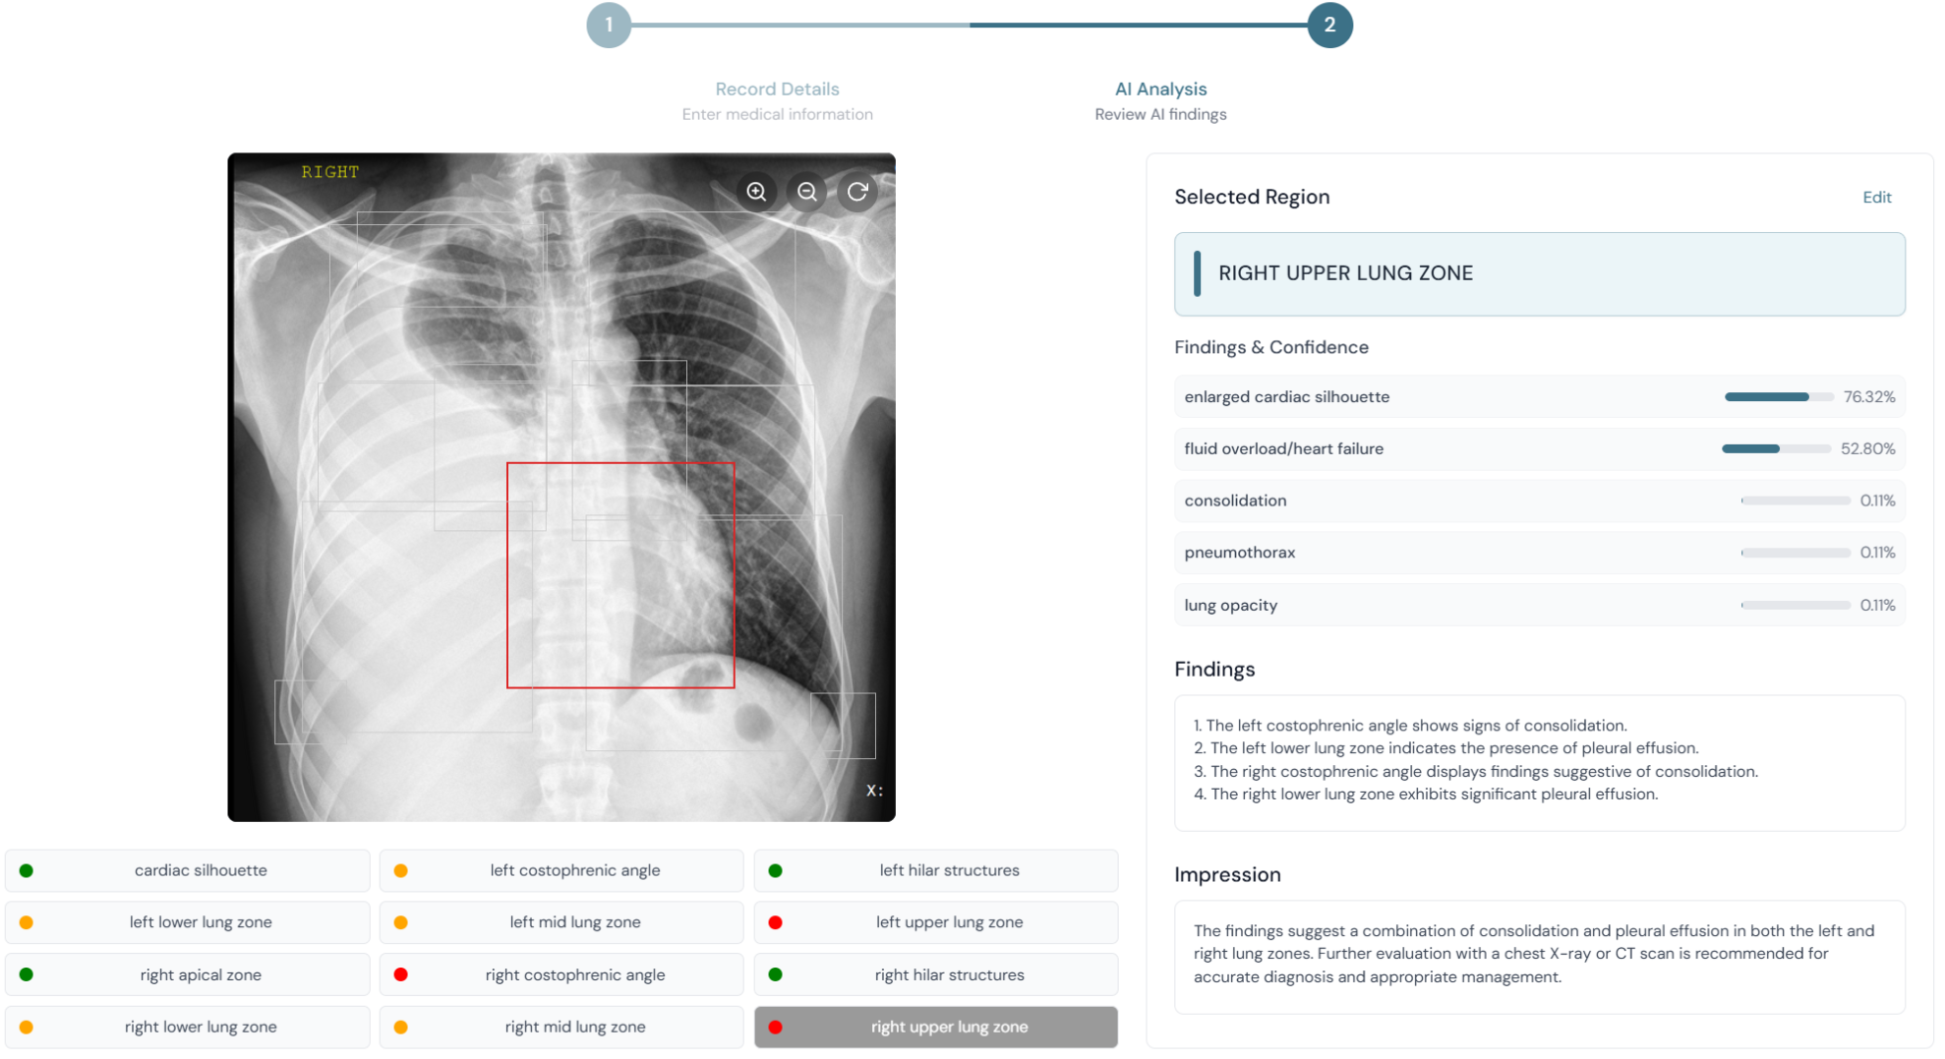
Project Motivation
Chest X-ray is the most widely used imaging tool for detecting lung conditions due to its accessibility and affordability
Radiologists interpret chest X-ray images manually, which can be time-consuming, subjective, and prone to diagnostic errors
An ideal AI system should accurately identify diseases, pinpoint their exact anatomical locations, and reliably track changes over time, improving efficiency and diagnostic precision for radiologists

Slide 4
Functional Requirements
Core Functional Requirements:
Model at least 85% accuracy
The system should detect diseases such as pneumonia and other cardiac conditions in chest X-rays with a minimum accuracy of 85%
System produces readable report
The system will generate structured, human-readable reports that summarize key findings, confidence levels and disease progression status
Confidence score of diseases
The system shall display confidence levels for disease detection and progression analysis results through an intuitive user interface
Notes:
We have numerous non-functional and functional reqs for our project but I will only be mentioning the top three requirements for the sake of time.
As for our functional-requirements:
First, it must accurately detect diseases such as pneumonia and cardiac conditions from chest X-rays, with a minimum accuracy of 85%.
Second, it should generate clear, structured, human-readable reports that highlight key findings, confidence levels, and disease progression.
And third, the system must present results through an intuitive interface, allowing doctors to easily interpret confidence levels and track changes over time.

Slide 5
Non Functional Requirements
Core Non-Functional Requirements:
Simple and intuitive interface
The design of user interface for this system must be simple and intuitive, allowing healthcare professionals to use the platform efficiently
Data encryption on uploaded image
The system should ensure that users feel secure when uploading X-ray images by implementing strong data encryption and offering enhanced security feature
Report approval by professional
AI generated diagnoses are reviewed and confirmed by a qualified radiologist before being used in patient care decision
Notes:
As for our non-functional-requirements:
First, the user interface must be simple and intuitive to ensure healthcare professionals can use it efficiently.
Second, strong data encryption and enhanced security features must be in place to make users feel safe when uploading sensitive X-ray images.
Third, all AI-generated diagnoses must be reviewed and confirmed by a qualified radiologist before they are used to support patient care decisions.

Slide 6
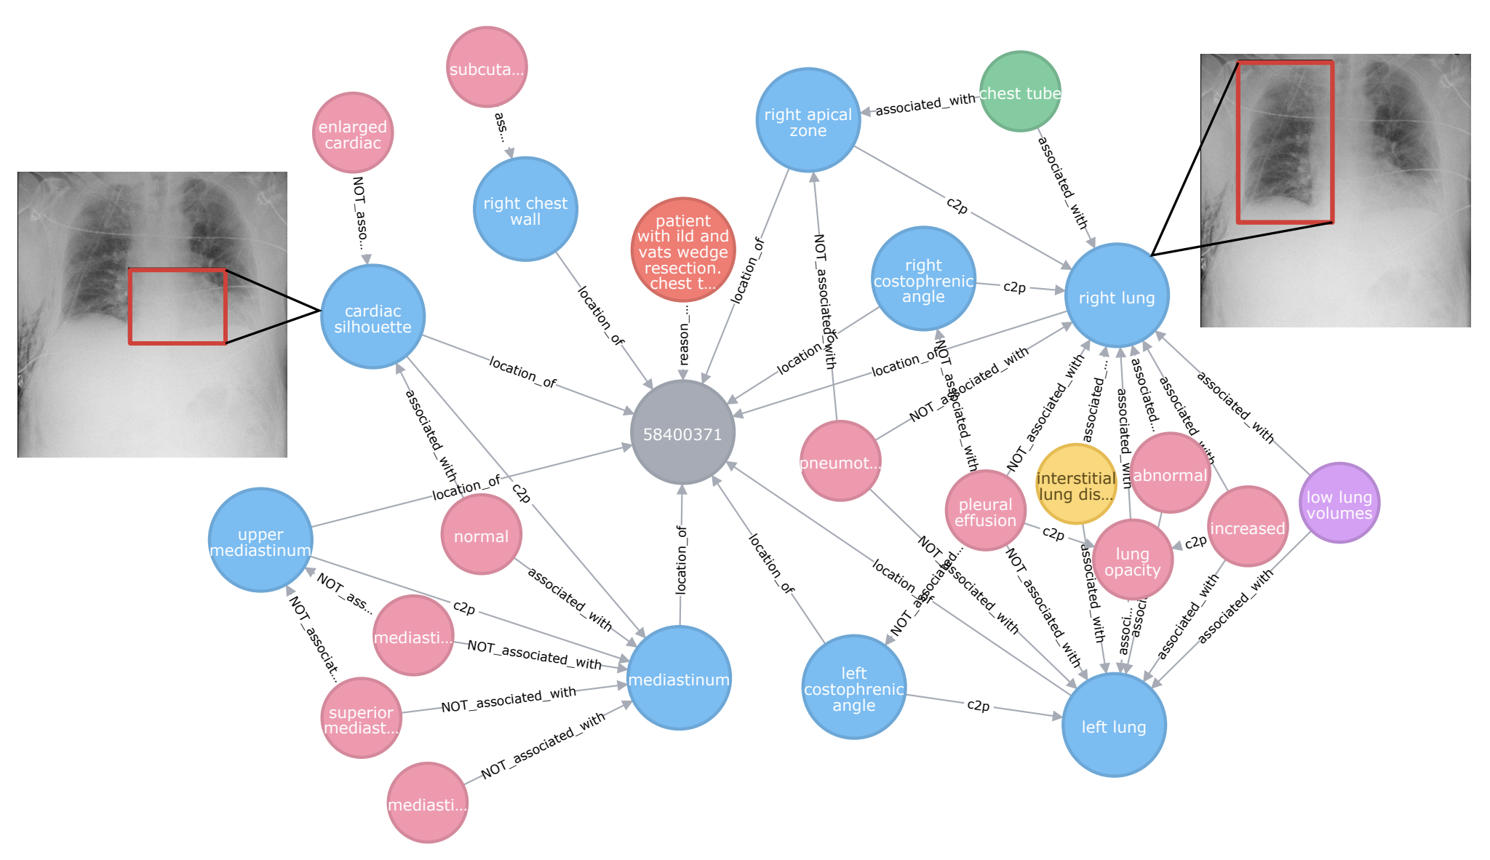
Dataset
Chest MIMIC-CXR Dataset (500GB+) :
237,827 frontal chest X-ray (CXR) images
automatically annotated (silver-standard)
500 manually validated cases (gold-standard)
Uses chest X-ray images sourced from the MIMIC-CXR dataset

Slide 7

Deep Learning

Slide 8
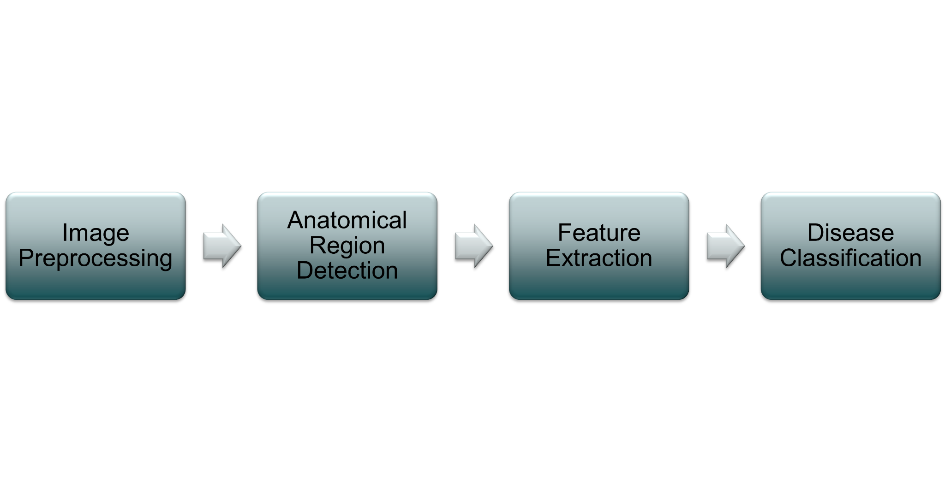
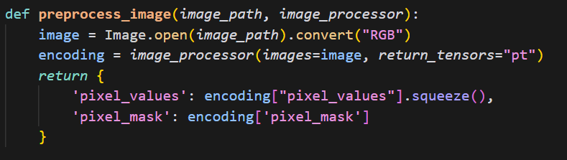
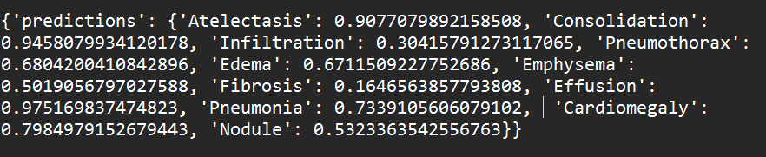
Deep Learning Pipeline

Slide 9
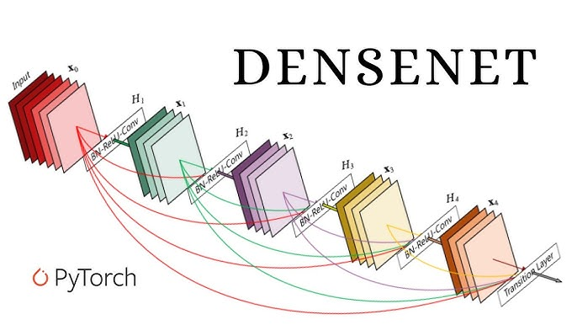
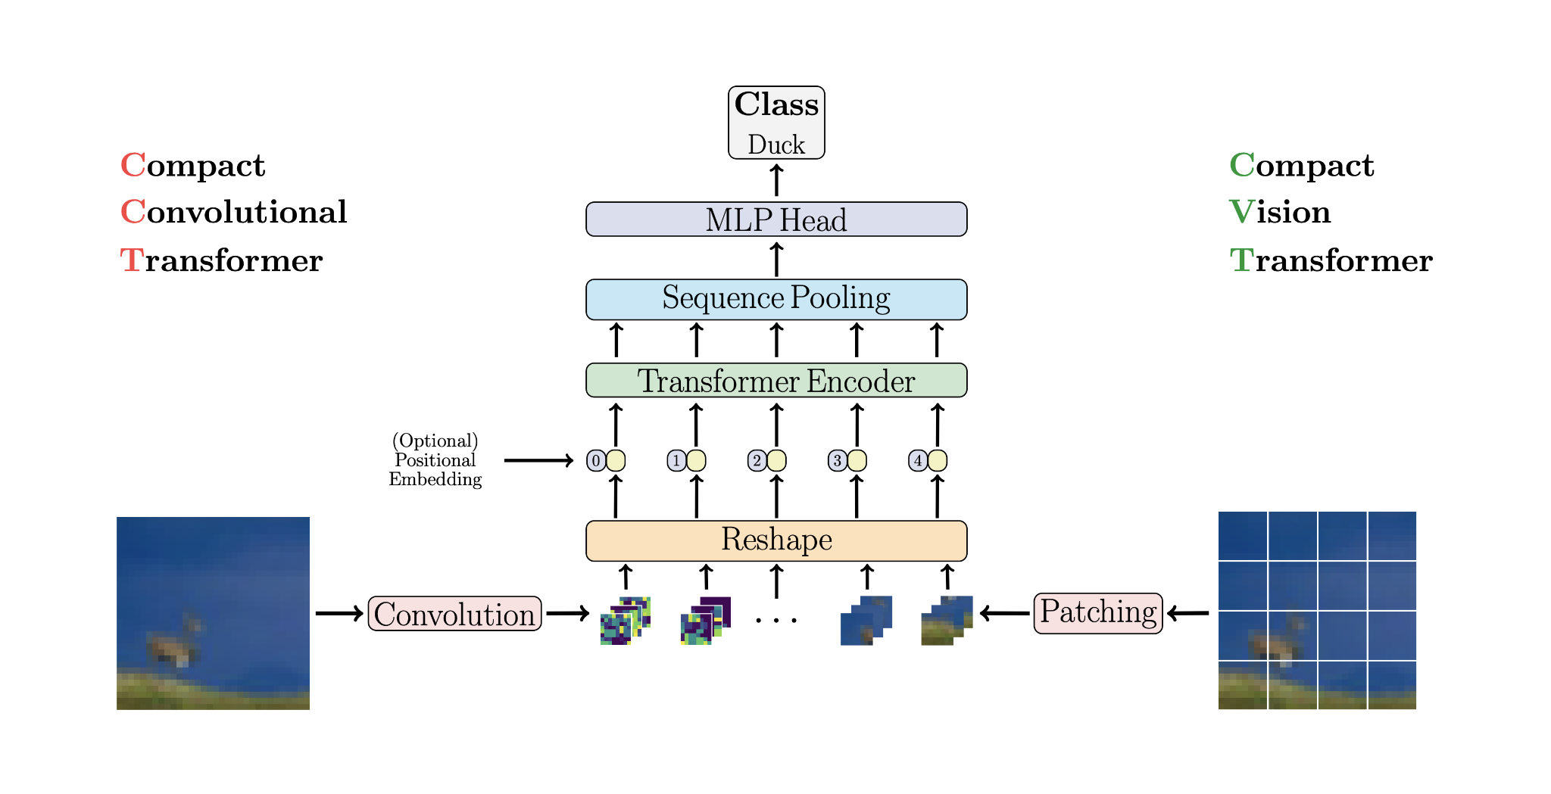
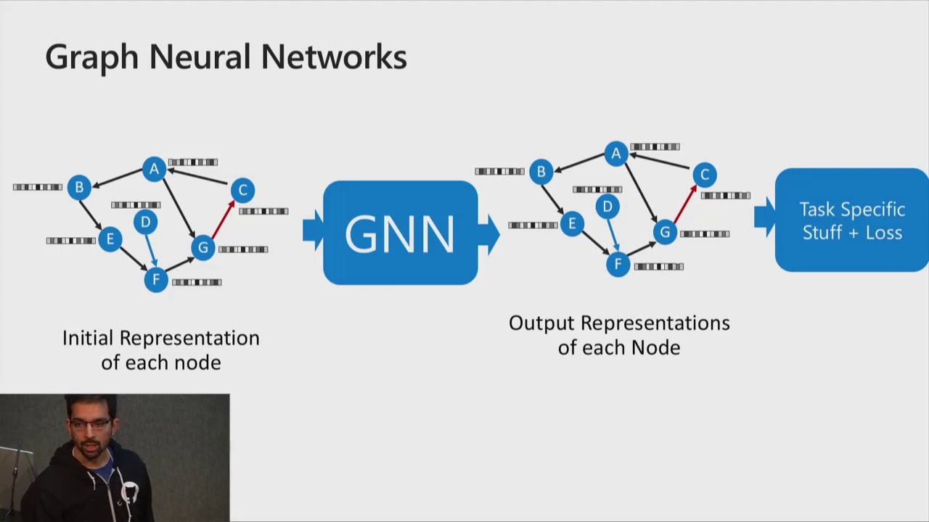
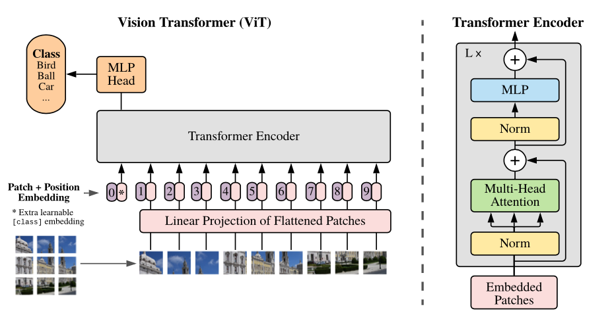
Model Selection
Notes:
Here is the full view on our github of our CI/CD pipeline

Slide 10
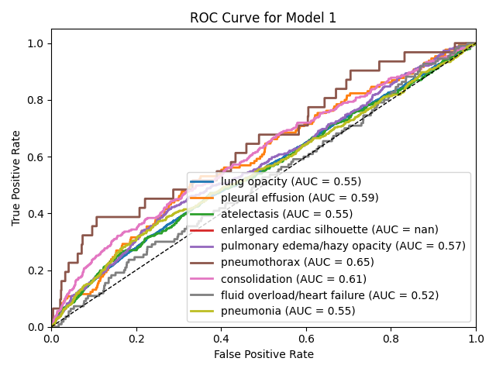
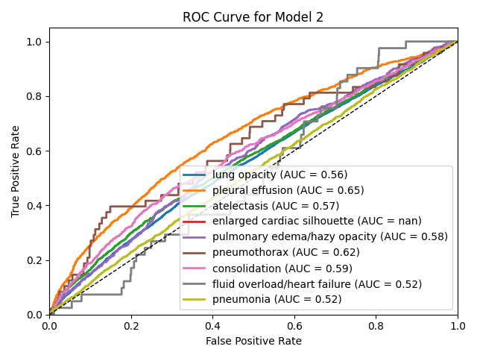
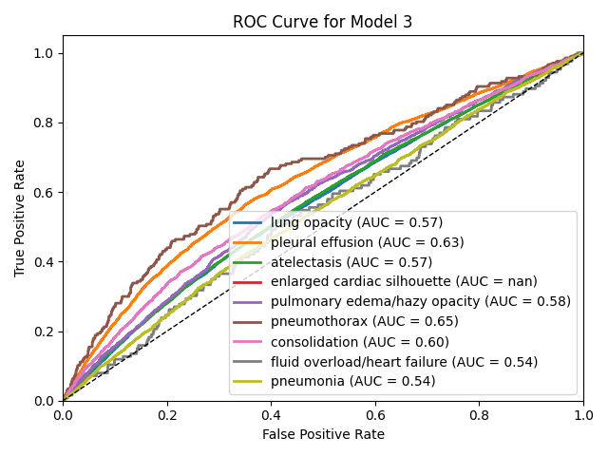
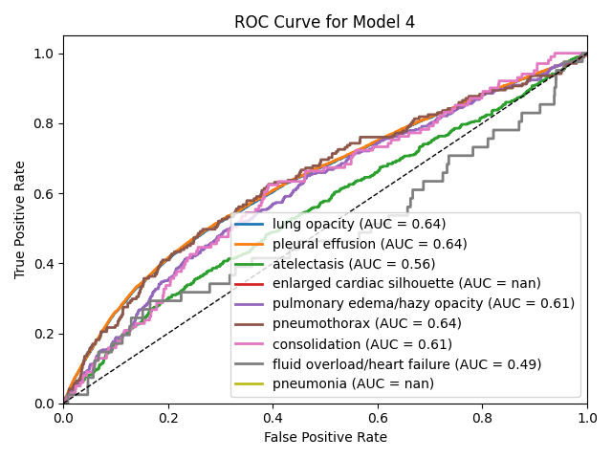
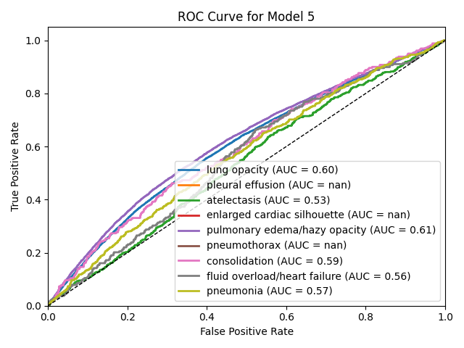
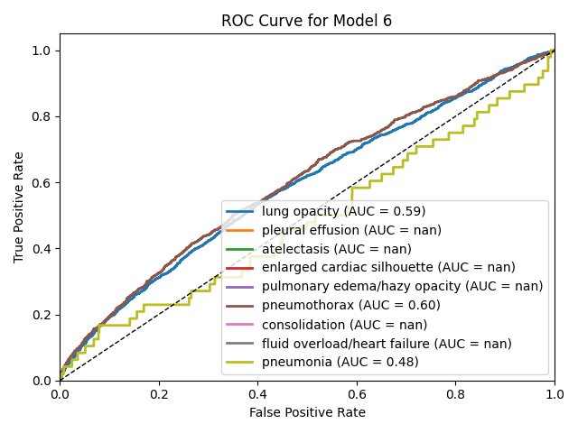


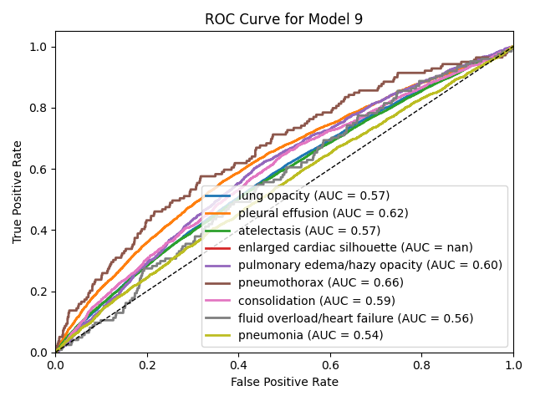
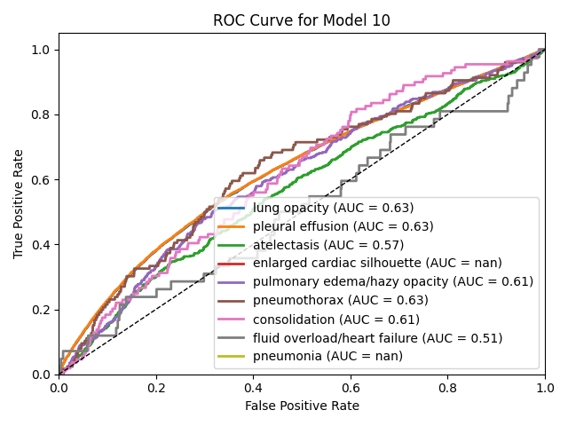
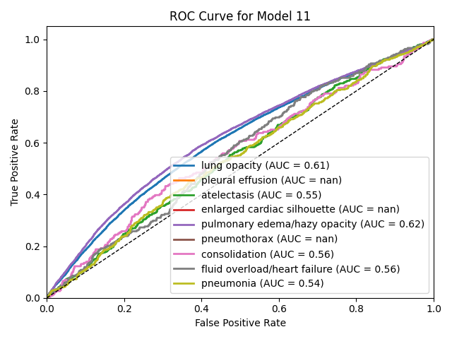
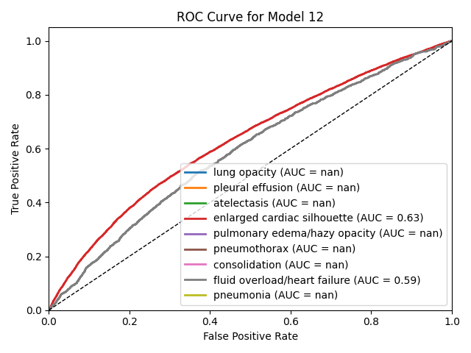
Comparisons

Slide 11
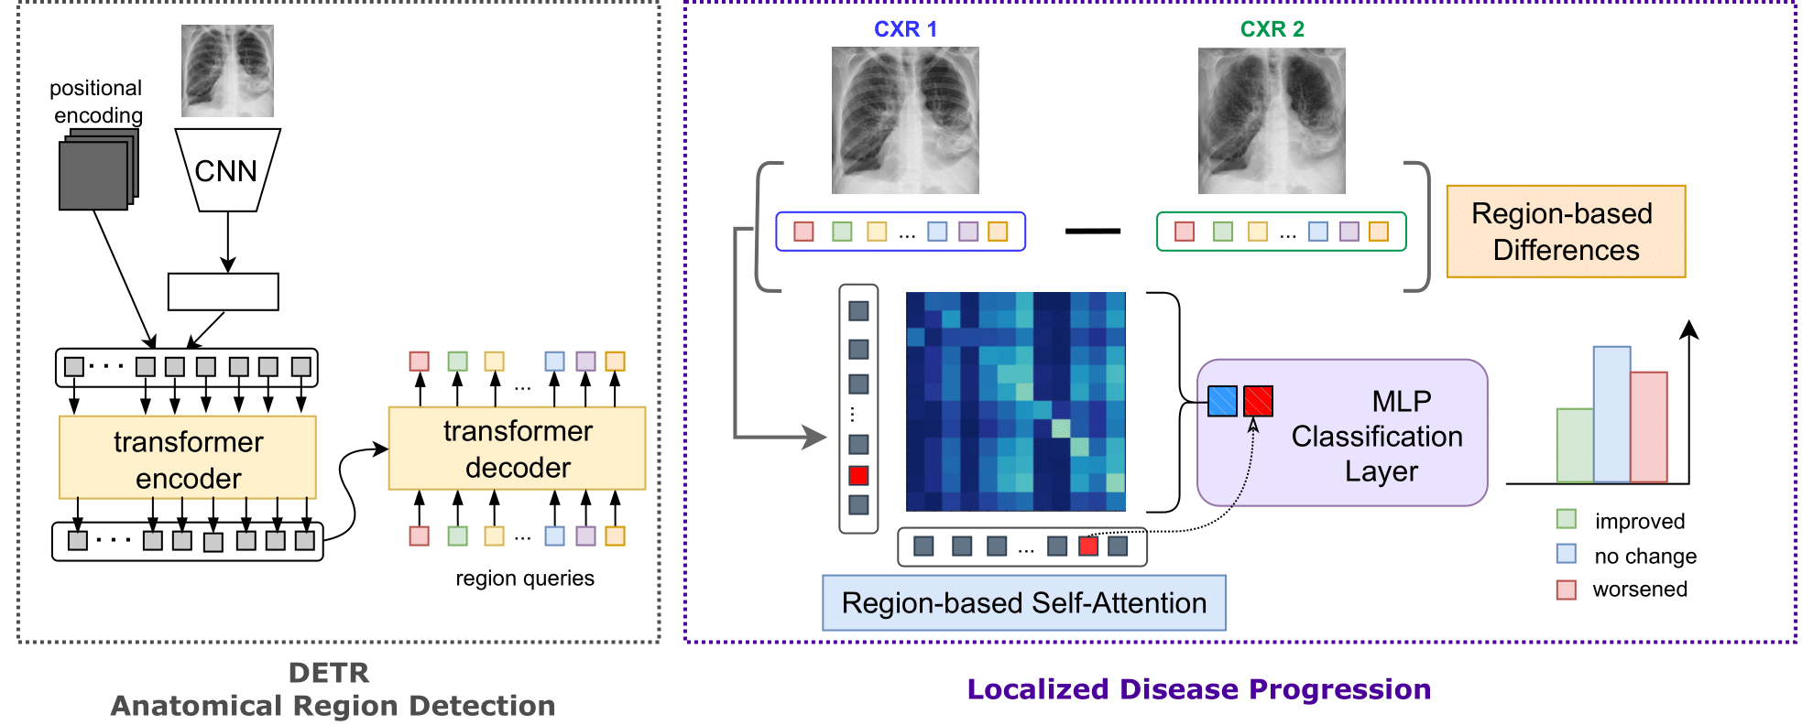
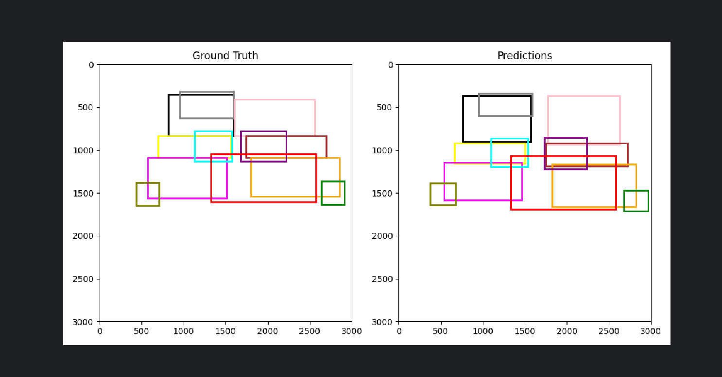
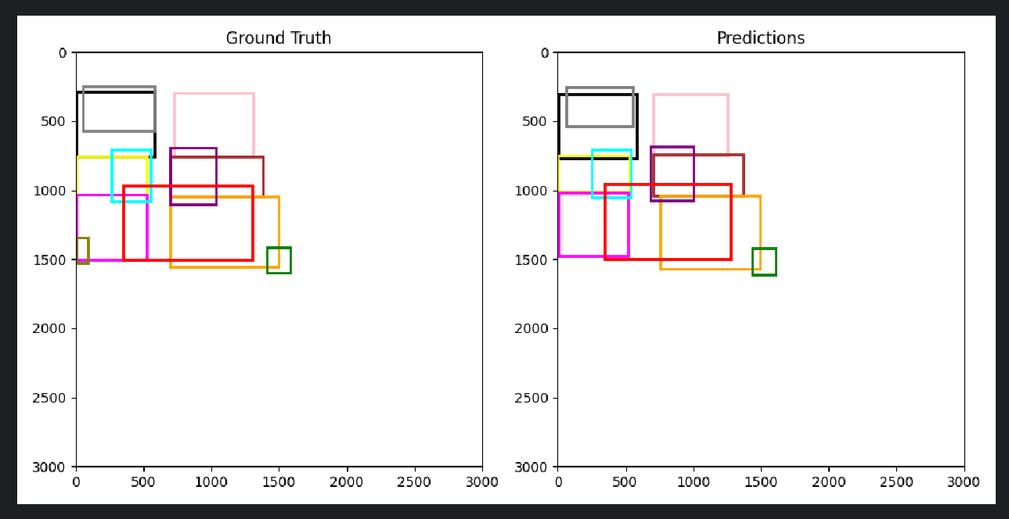
DETR Segmentation

Slide 12
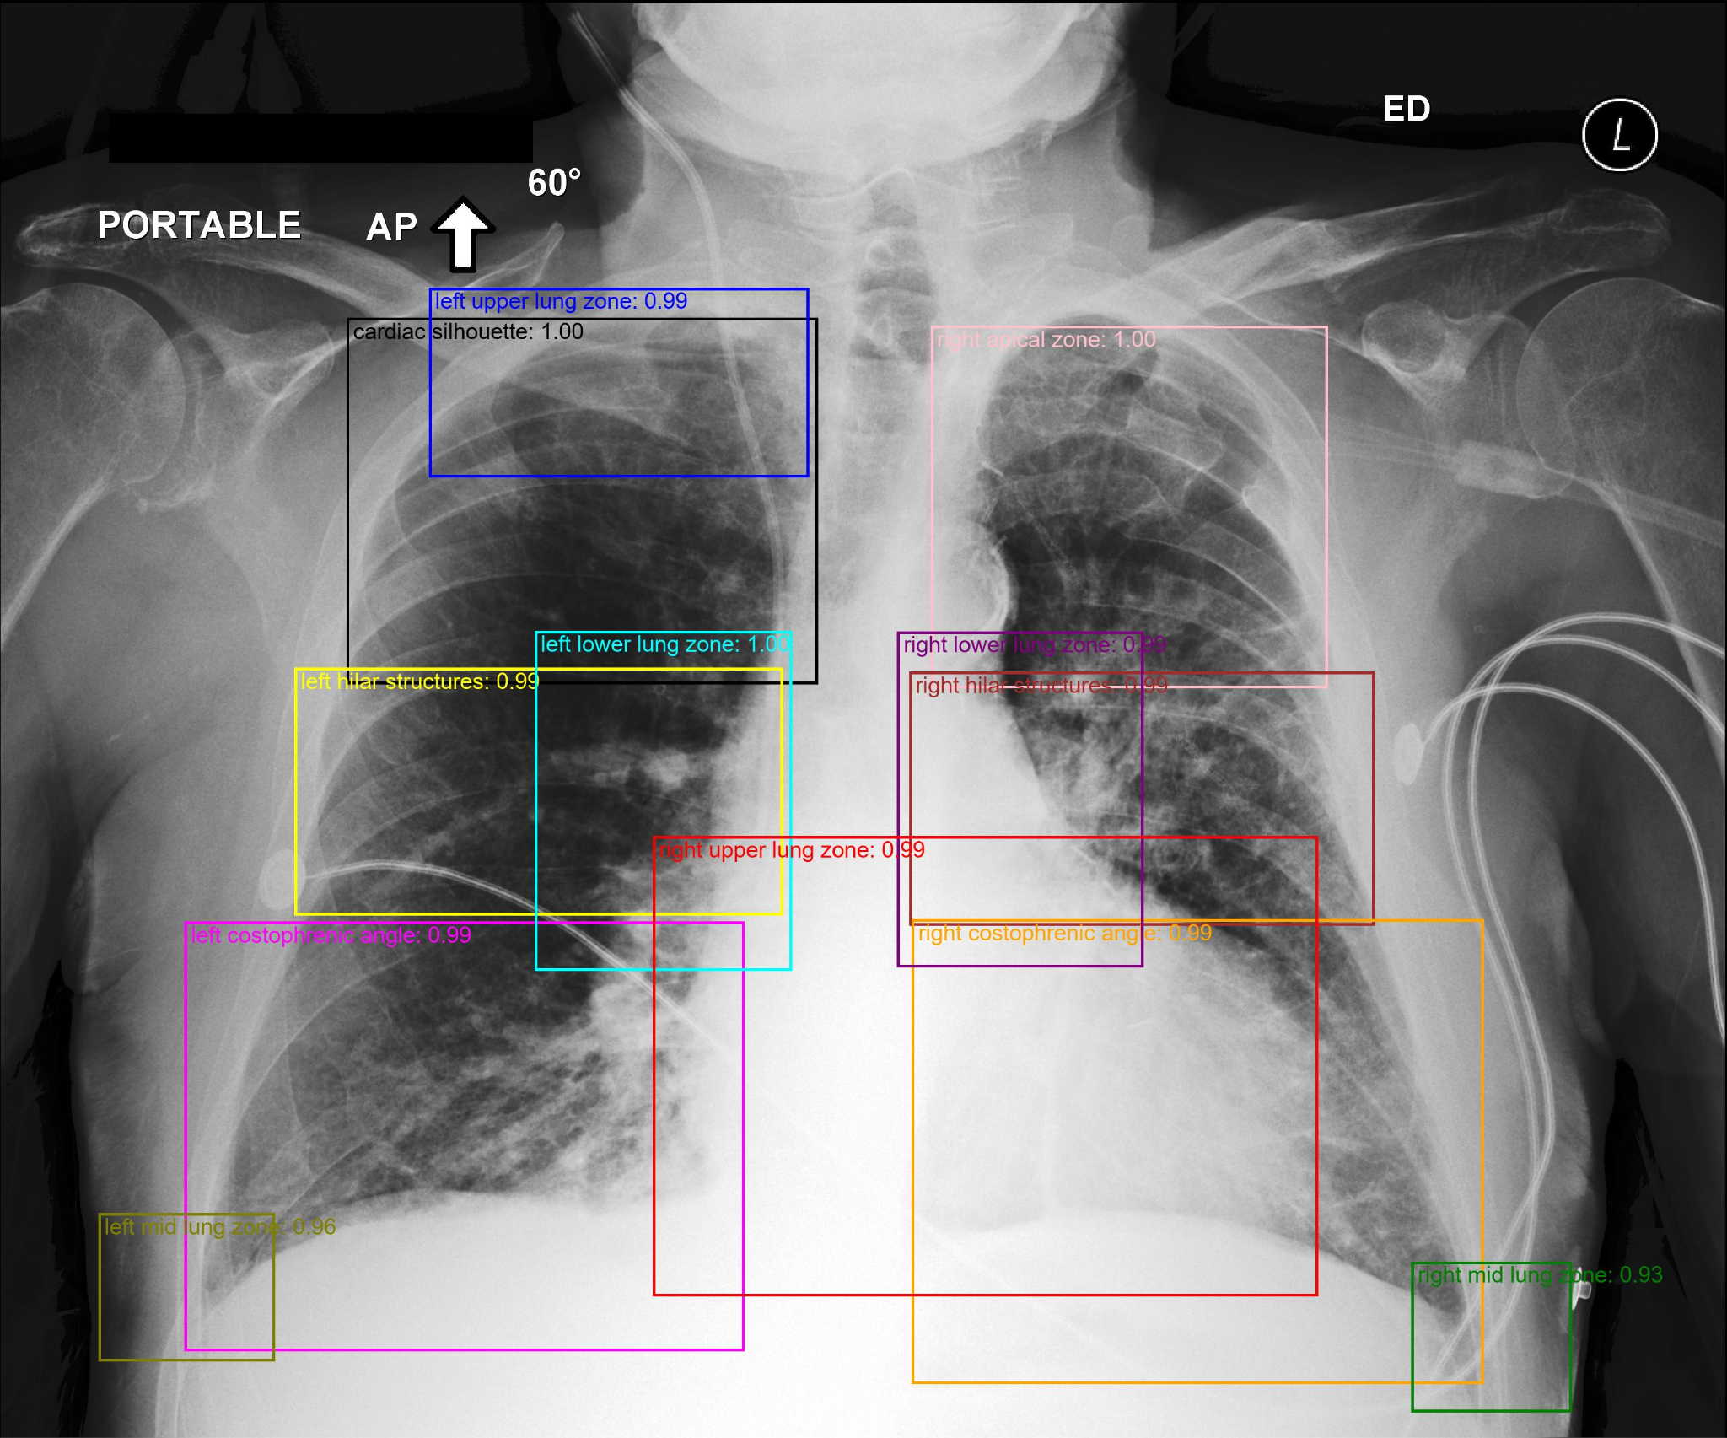

Slide 13
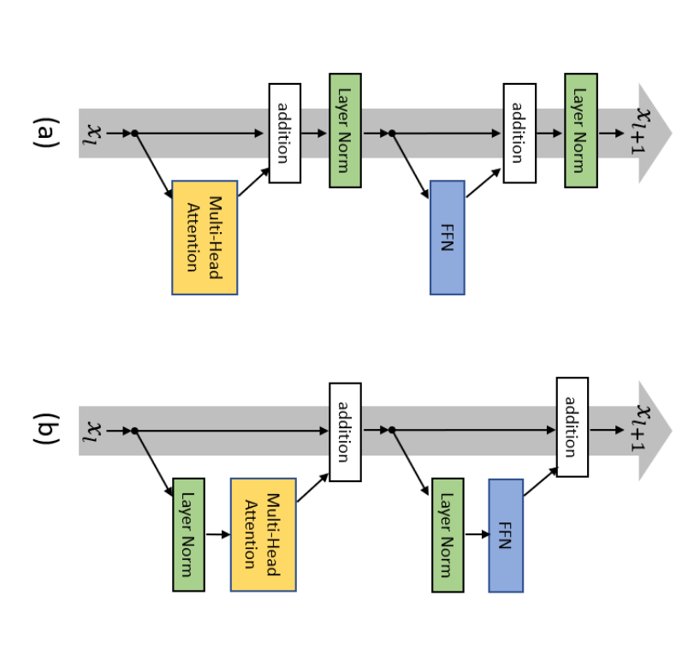
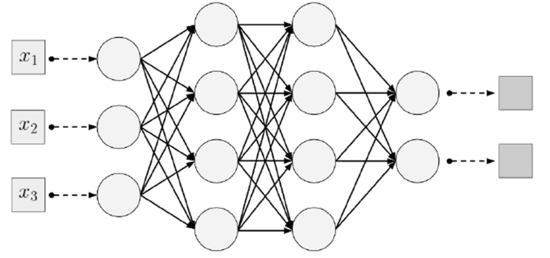
Disease Classification

Slide 14
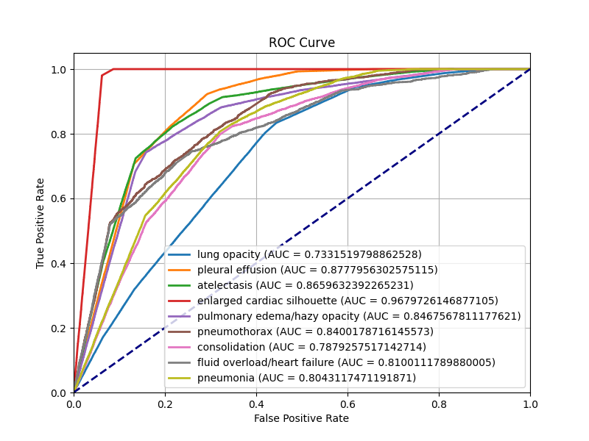
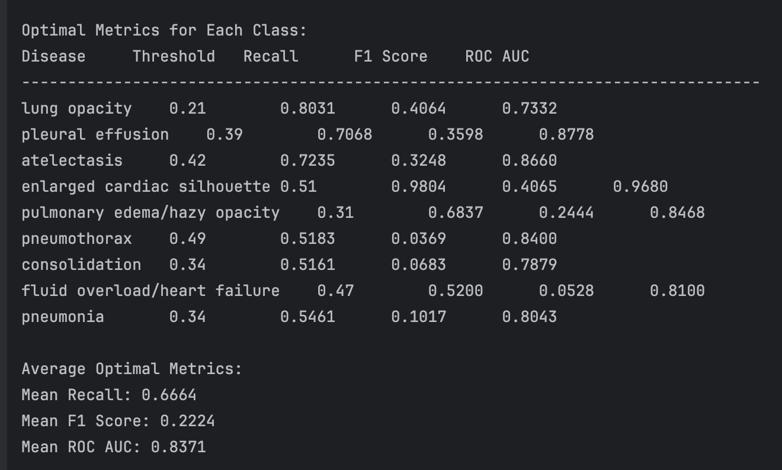
Model Benchmarks

Slide 15
Software Architecture

Slide 16
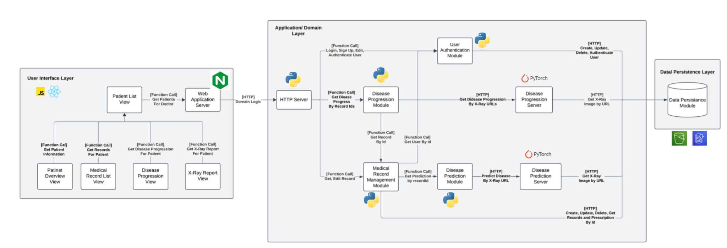
High Level Architecture
Notes:
This diagram shows a high-level overview of our system architecture
On the left, we have the User Interface Layer built with React JS. Doctors can access different patient views—such as records, progression, and X-ray reports through patient list. All UI interactions are handled by the Web Application Server using Nginx.
In the middle, we have the Application and Domain Logic Layer. It includes several Python-based services
The User Authentication Module handles login and security,
The Medical Record Module manages patient data,
The Disease Progression and Prediction Module use PyTorch to analyze X-rays and provide analysis.
These modules communicate via HTTP or internal function calls.
Lastly, on the right, we have the Data Persistence Layer, where all data—like patient records and X-ray images—is stored in a secure database.
This was designed to ensure a modular and scalable product to generate real-time predictions, data integrity, and a seamless experience for medical professionals.

Slide 17
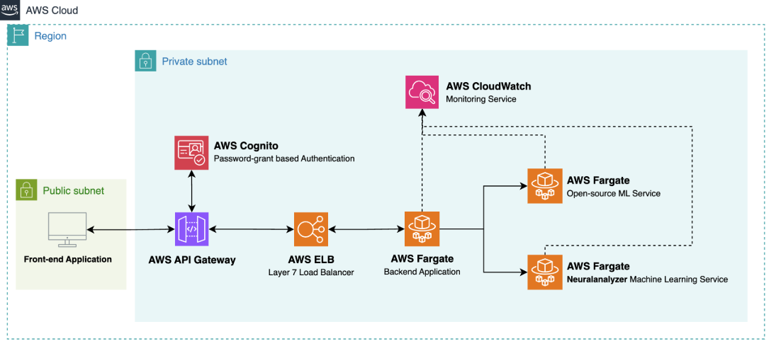
AWS Implementation

Slide 18
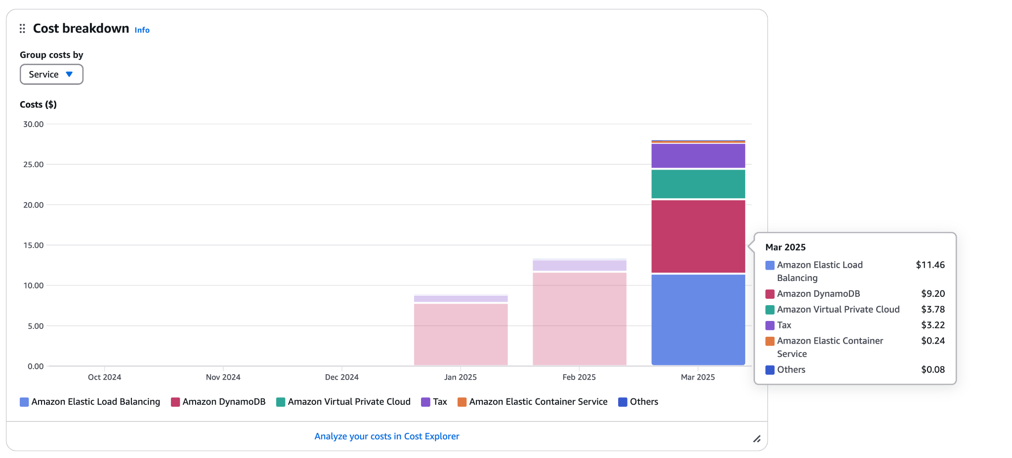
AWS Cost Overview

Slide 19
CI/CD PIPELINE

Slide 20
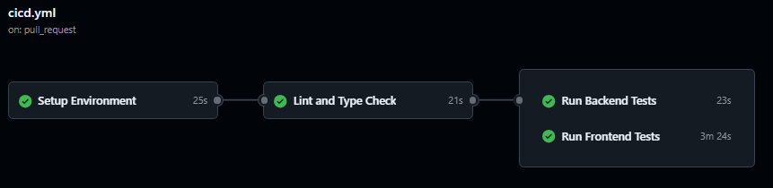
Workflow Continuous Integration (CI)
Setup Environment
Lint and Type Check
Checkout Code
Set up Python
Cache and Install dependencies
Run flake8 for style
Run flake8 for static analysis
Upload flake8 report
Notes:
CONTINUOUS INTEGRATION
Continuous Integration (CI) is the backbone of our development process! Every time a developer pushes code or opens a pull request, our CI pipeline kicks in—automatically validating changes, catching issues early, and keeping our codebase stable.
We begin with the Setup Environment stage. This includes checking out the latest code from the repository, setting up the Python environment, and caching dependencies. By caching dependencies, we speed up builds, reducing wait time for developers.
Once the environment is ready, we move on to the Lint and Type Check stage. Here, we use flake8 to enforce style guidelines and detect any Python syntax issues or possible bugs through static analysis. After running the checks, we generate and upload a detailed report, which helps developers address issues before their code is merged. Linting helps catch small issues before they become bigger problems.

Slide 21
Workflow Continuous Integration (CI)
Run Backend Tests
Run Frontend Tests
Execute unit and integration tests
Measure code coverage
Upload test results
Set up Node.js
Install dependencies
Run frontend tests
Upload test results
Notes:
With code quality verified, we move to Testing, starting with Backend tests are executed first, including both unit and integration tests. We also measure code coverage to assess how well our tests cover the codebase. These results are uploaded for review, ensuring that our backend remains stable.
With backend tests complete, we shift focus to Frontend Testing. We set up Node.js, install necessary dependencies, and run automated UI tests. Again, results are uploaded to maintain visibility into test outcomes.
TRANSITION
At this point, every piece of code has been checked, tested, and validated. But testing alone isn’t enough—we need to get our changes into production! That’s where Continuous Deployment (CD) comes in.

Slide 22
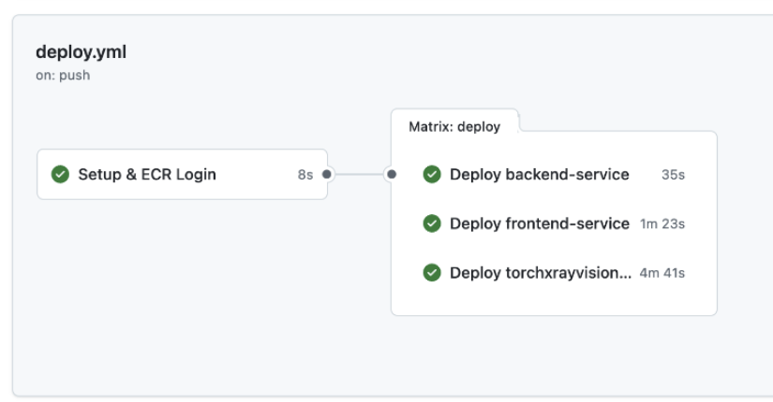
Workflow Continuous Development (CD)
Dockerization
AWS Deployment
Our application is built into a Docker container.
We use an augmentable approach
The app is deployed to ECS (Elastic Container Service)
A load balancer manages incoming traffic.
Notes:
CONTINUOUS DEPLOYMENT
We begin with Dockerization. Our application is built into a Docker container, which ensures it runs consistently across environments — whether it's a developer’s machine or a cloud production server. We’ve adopted an augmentable Docker approach, which means the container can be extended or customized for different deployment scenarios.
Once the container is built, we move to AWS Deployment. The Docker image is deployed to AWS ECS — Elastic Container Service — which provides a scalable and reliable environment for running containers. We also configure a load balancer to handle incoming traffic, distribute requests across containers, and ensure high availability even under load. This setup supports both the frontend and backend services, which you can see listed in the table at the bottom.
Overall, this CD pipeline supports rapid, safe, and repeatable releases — which is crucial for iterative product development and real-time feature delivery in healthcare environments.

Slide 23
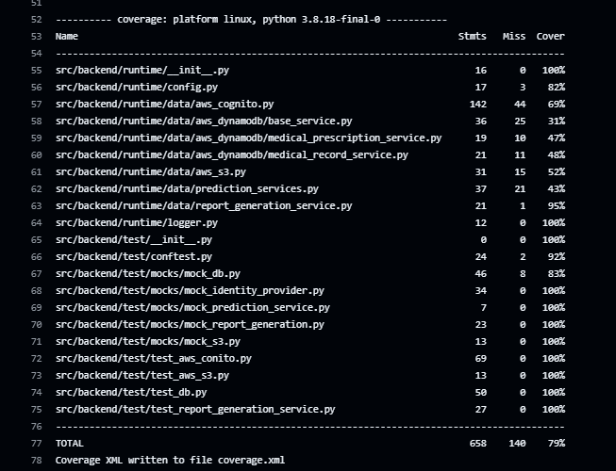
Test Coverage Python
Overall test coverage: 79% across 658 statements.
Core modules like logger implementation, test mocks, report generation reaches 95-100% coverage.
Difficult to fully test cloud services (complex mocking frameworks, multi-step authentication flows, service updates change API contracts)
AWS DynamoDB services/base_service: 31%
Medical-related services: 43-52%
Notes:
As previously mentioned during our CI/CD process, tests are done and tracked to give a report of our overall test coverage as you can see on the right side. Most of the core modules are very well covered ranging from 95 to 100% .
However, we observed lower coverage in some of the cloud service integration areas, which are more difficult to test because of complexity of mocking cloud interactions, multi-step authentication, and frequent API contract changes. For example, modules involving AWS DynamoDB or medical service logic show coverage between 31% to 52%
Despite that, we’ve prioritized the most critical components and maintained strong coverage where it matters most to ensure stability and reliability.

Slide 24
PERFORMANCE

Slide 25
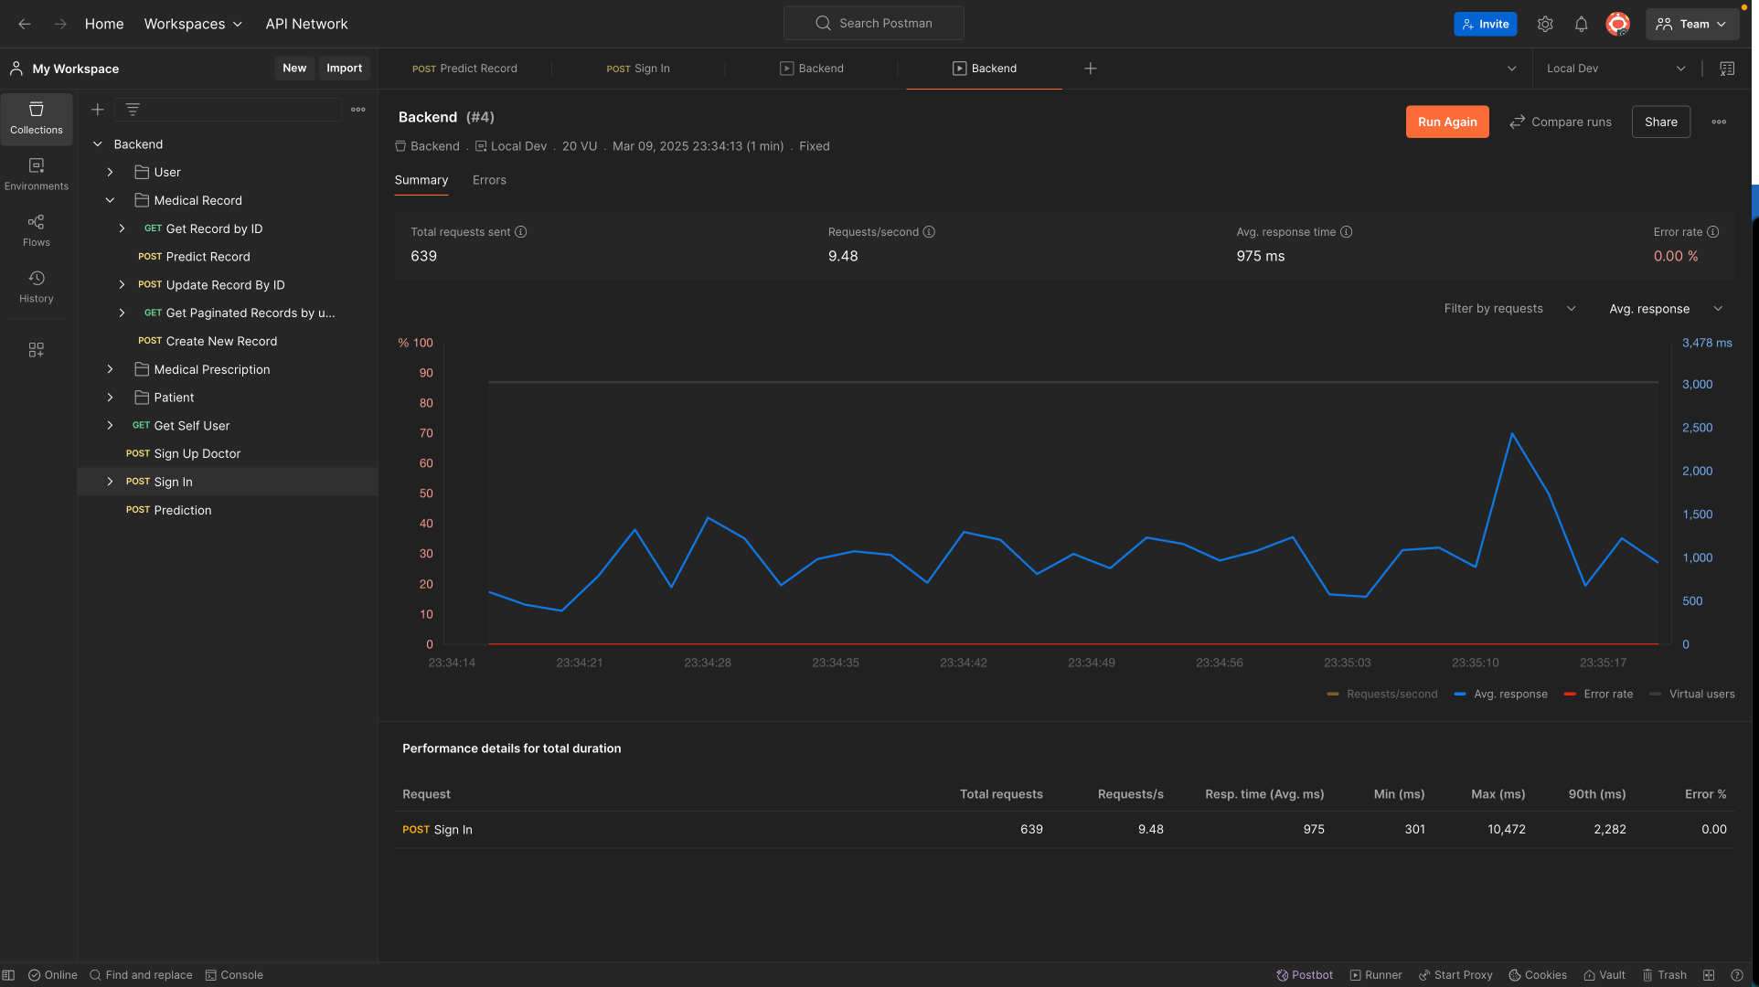
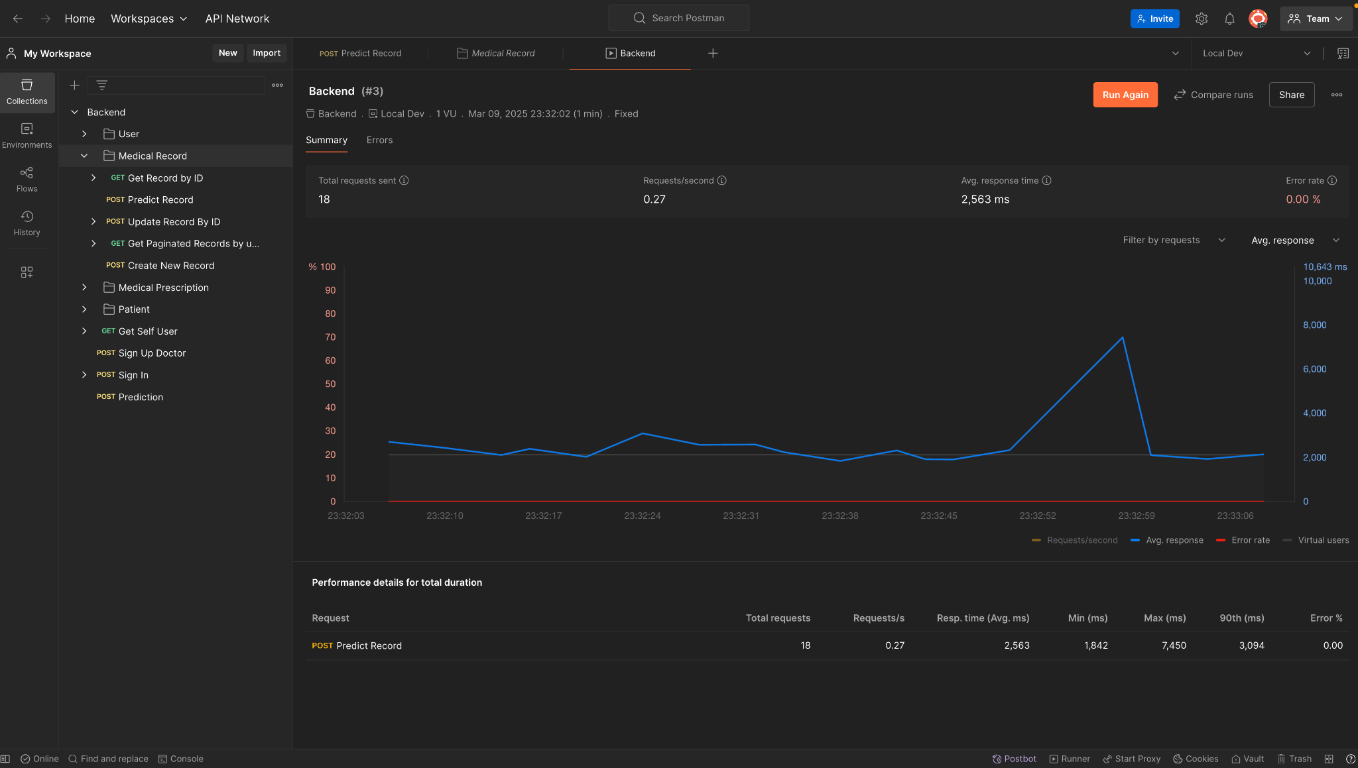
Performance
The system supports up to 20 concurrent users running the AI model on a MacBook without ANY dedicated GPU. It could easily support up to ~1000+ of users on Tensor core servers. (Batch size of 8192 on H100 Tested!!!)
Notes:
Our system shows the strong performance and scalability. It can support up to 20 concurrent users running the AI model locally on a MacBook without any dedicated GPU.
For larger-scale deployments, the system easily scales to over 1,000 users when hosted on Tensor Core servers like the NVIDIA H100. We’ve also tested this with large batch sizes.
Here, we show two Postman dashboards tracking backend response times. Right one shows the response time of our AI model and the Left one shows the response time our system.The average response times remained stable and well within acceptable limits.

Slide 26
Accomplishments

Slide 27
Accomplishments
Novel localized disease detection with accuracies (83%) close to state of art
Integration of Patient treatment plans and history to mitigate AI bias
Automatic Report Generation
Incorporation of industry-standard techniques to develop, deploy, and secure a cloud based application.
Example: CI/CD pipeline, AWS securities, Infrastructure as Code, etc
Future steps:
Integrate Disease progression to monitor to be able to monitor patient status more regularly
Fine tune the model to recommend treatment plans

Slide 28
LIVE DEMO

Slide 29


THANK YOU!
Try it yourself! https://neuralanalyzer.ca/

